Slide 1
Intro To Android Development

Slide 2
Android, a software stack for mobiles.
Android SDK( Software Development Kit) is used to develop various applications.
Android studio is one of the SDK we’ll use to develop applications.
So without wasting let’s get to our SDK i.e. Android Studio.

Slide 3
Android Studio is a SDK we’ll use to develop apps, InteliJ, Swift are other examples of SDK to build application.
Flutter, a technology introduced by google which is an SDK used to develop Native app, can be operated in IOS, android or other mobile systems. May be will work on it later.
Introduction to android studio by making a simple application:

Slide 4
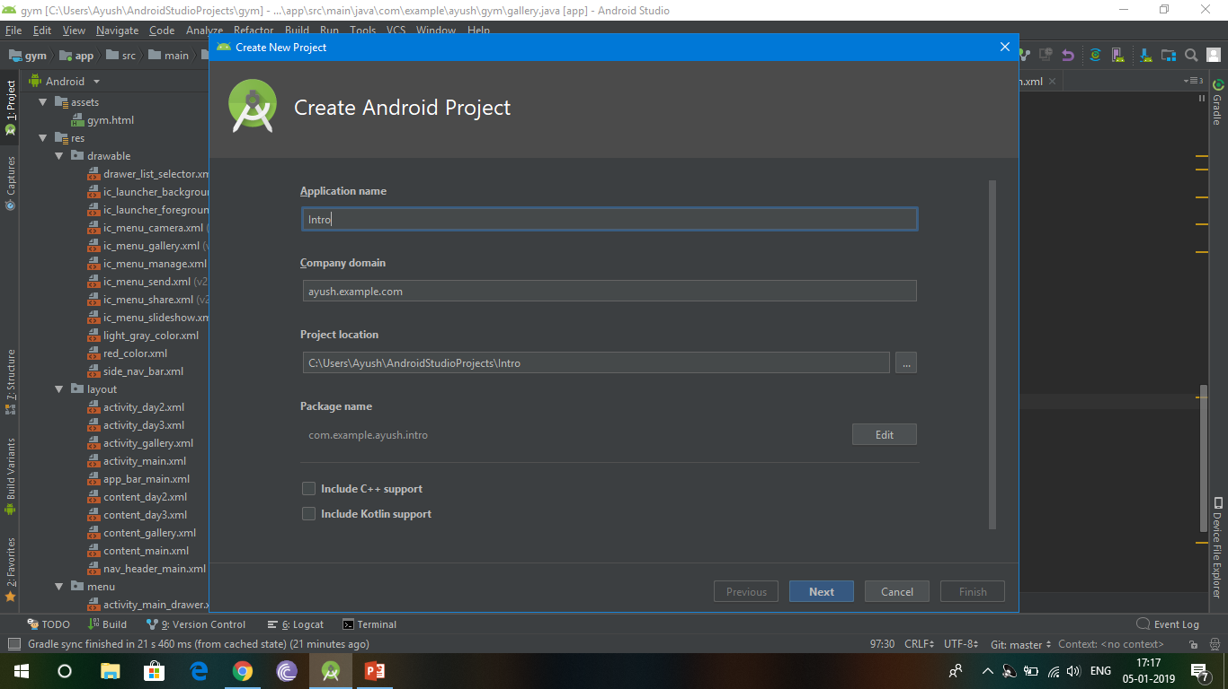
Step 1: Download Android studio and JDK in your PC. Open it and choose start new project.
Step 2: Give a name to your application.
Project Location

Slide 5
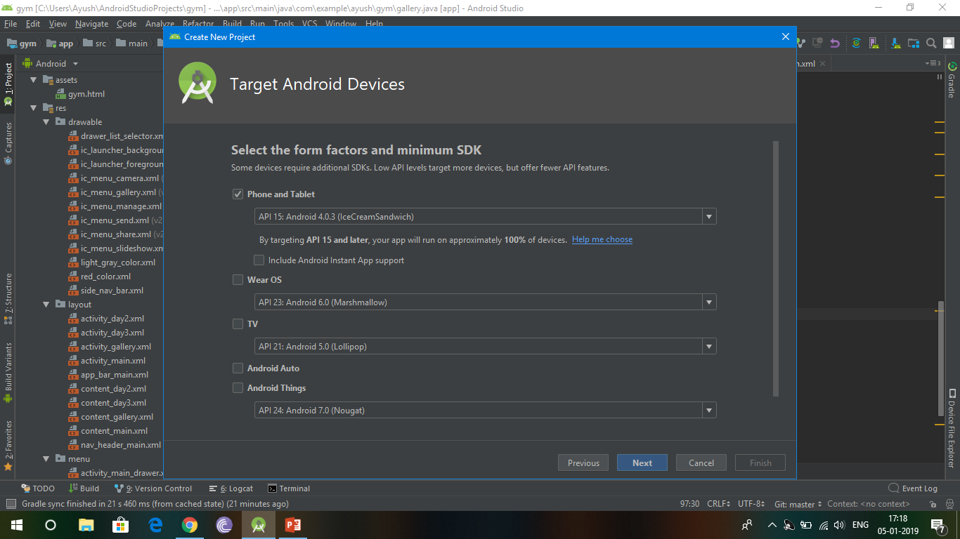
Step 3: Give an API version (Android Program interface, it is the version for which
we are developing the application).Here we set API at, API 15: that is
Ice-cream sandwich (4.0.3).

Slide 6
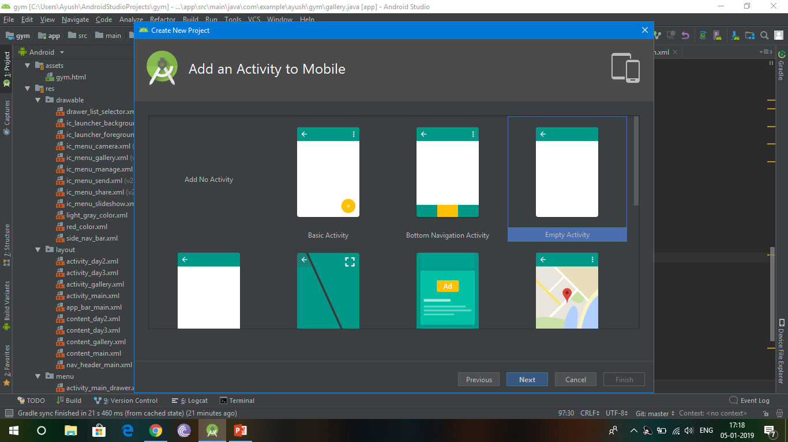
Step 4: Add an activity( Activity is a screen with which user directly interacts, as well as
user can also do various things like input, output etc.). Here we set the activity
to empty activity which contains nothing but a screen. Then click next and
then finish.

Slide 7
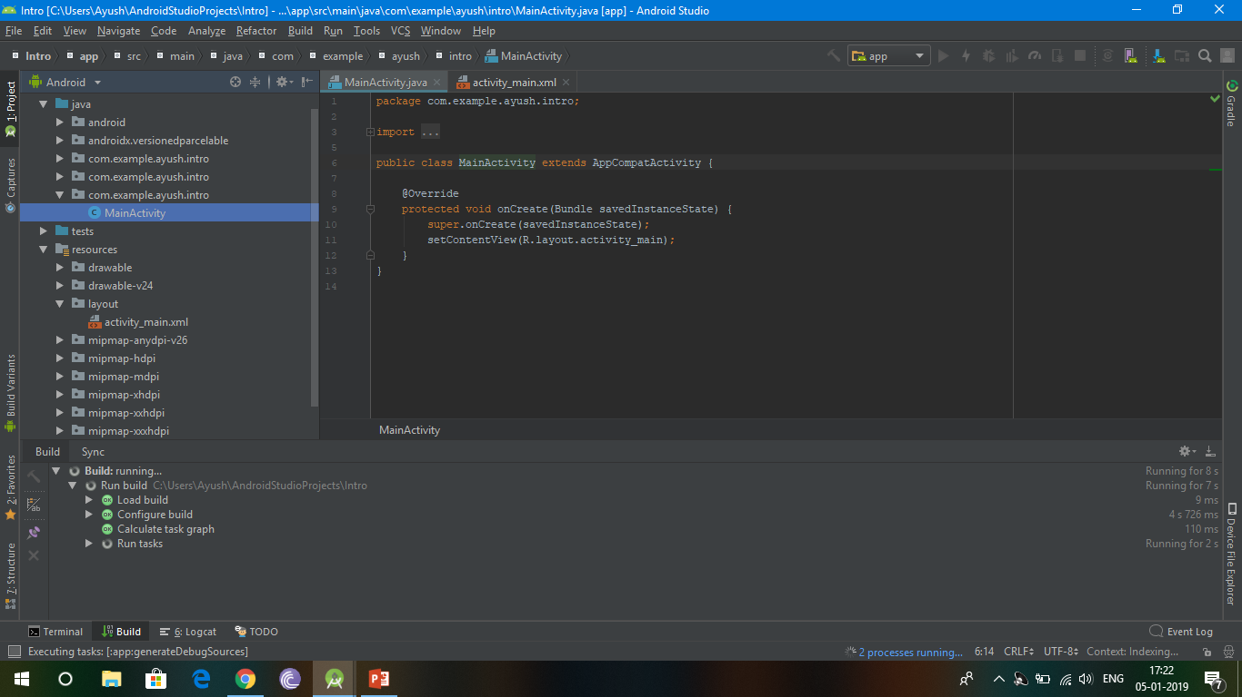
This is the screen you got after clicking finish. On the left, we can see all the files. Java file includes the logic
Behind your app. For example, if else conditions, what happen if one clicks a button etc.
There is also a
Layout file which
Includes the layout
Of the application.
Layout file has an
Extension, XML in
Which we can add
Buttons, textview,
Webview etc.

Slide 8
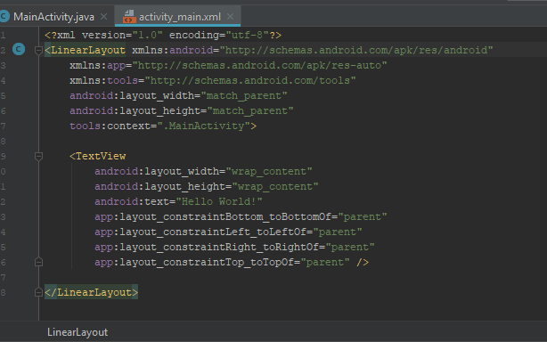
So, lets get started with an application which just shows “ Hello World” or any text on screen.
This is the XML, named “activity_main.xml” . In which we describe various things like
buttons, textview etc.
First we have to give a layout, ( Linear Layout, Relative layout etc ) in which we give
we describe the height, width etc for the layout. I set the layout to linear but you can also
leave it as default i.e. constraintlayout.
Then, we add a widget (it is a miniature application, eg. Text view, Button, web view etc
Here we are adding “TEXTVIEW” to show out desired sentence in application.
Text view widget is a widget which shows
only text on the application’s screen.
In this, we have to describe every things like
Height, width, where it will be shown on screen etc.

Slide 9
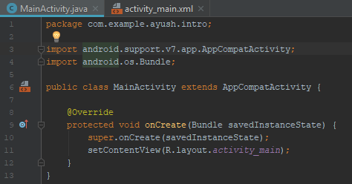
After this we have to edit our .java file which contains logic behind our app.
In this application, we just have to give the logic that use our activity_main.xml
File to set the view of app.
So the code is,
Java is a pure object oriented language so we have to include all our code in a
Class.
Here, Mainacticity is our class name, else are the default code which is there when
You open the .java file.
setContentView is used to set out application view,
Which is set to our .xml file.

Slide 10

After completing the xml & java file you just have to connect your android device to pc and install
The app by clicking the green button
This is the button used to build and install the app
So this is all about the first app. Try it and ping me if u have any query about it.

